Slide 1

VA Online Scheduling Stakeholder Monthly Review
October 6, 2020

Slide 2
Agenda:
Meeting purpose
PI planning reminder (Eric)
Demos – front end & backend
Roadmap & backlog review

Slide 3
Northstar Vision
Deliver a seamless and positive experience for
any Veteran who wants to schedule an appointment online.
Objective
Objective
Objective
Increase number of Veterans who are able to successfully request or schedule an appointment
Increase Veteran satisfaction with VA online scheduling experience
Decrease confusion in the online scheduling and appointment management process

Slide 4
VAOSR Product Principles
Veterans see appointments as a single experience. If the feature is not related to scheduling or canceling an appointment, it is a separate product.
Always give users a path forward. No dead ends.
Don’t use VA Online Scheduling to solve staff workflow problems.
Don’t ask VA Online Scheduling to solve bad data problems.
Don’t present Veterans with options they don’t have.
The burden of business rules is on us, not Veterans.

Slide 5
Purpose of the Monthly Stakeholder Demo + Roadmap & Backlog Review
Give the collective VAOS team a place to demo to all VAOS stakeholders what they have done in the past 2 sprints.
Give an overview of the roadmap for the next month, including what is in the backlog, how we are tracking against Program Increment (PI) goals.
Provide a space for stakeholders to discuss and ask questions about the roadmap/backlog, understand areas for escalation, and collectively agree on the direction forward for the next few weeks.

Slide 6
Goals of the Monthly Stakeholder Demo + Roadmap & Backlog Review
At the end of this meeting, participants:
Have seen the recent changes to the application’s front end, backend, and supporting services.
Understand the team’s priorities for the next sprint and how those priorities advance the program increment goals for this product.
Understand where specific user problems to be solved are in the backlog, as well as any related dependencies & blockers.

Slide 7
Stakeholder Expectations for the Monthly Demo + Roadmap & Backlog Review
Attend & be present. (Or, identify a representative on your team who can routinely attend). If you are representing a stakeholder, you have 2 main jobs in this meeting:
Take back applicable updates from this meeting to share with stakeholders/teams.
Follow up on decisions, outstanding questions, and action items assigned to you.
Follow-up on action items, outstanding questions, or decisions.

Slide 8
Front end (VA.gov) team

Slide 9
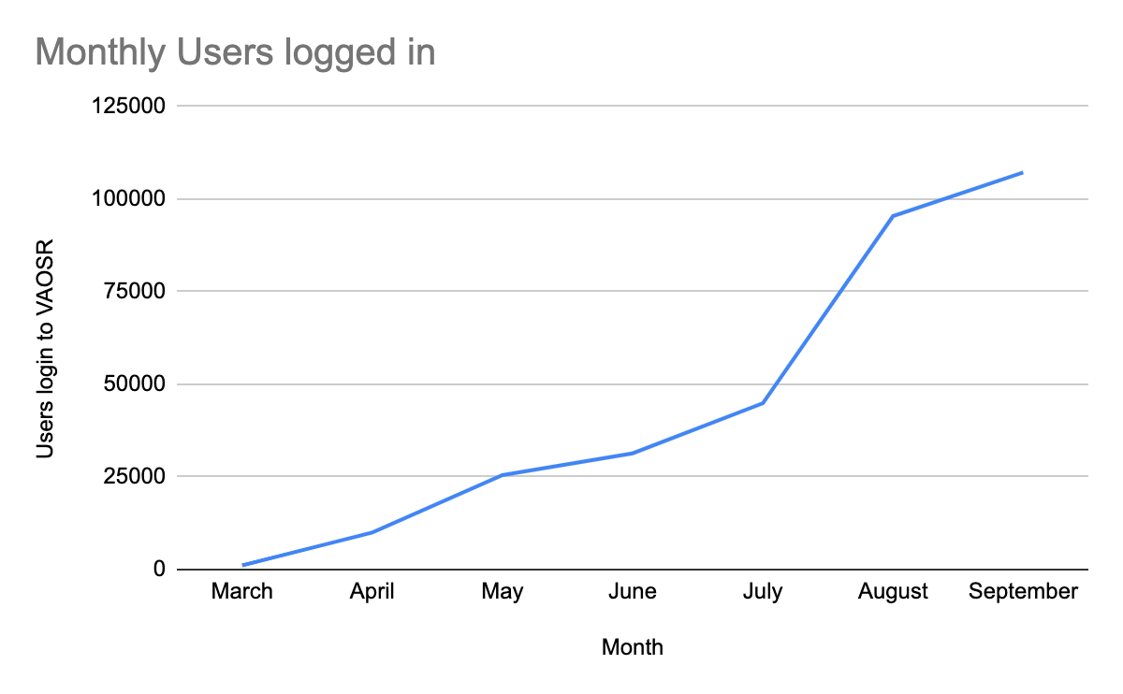
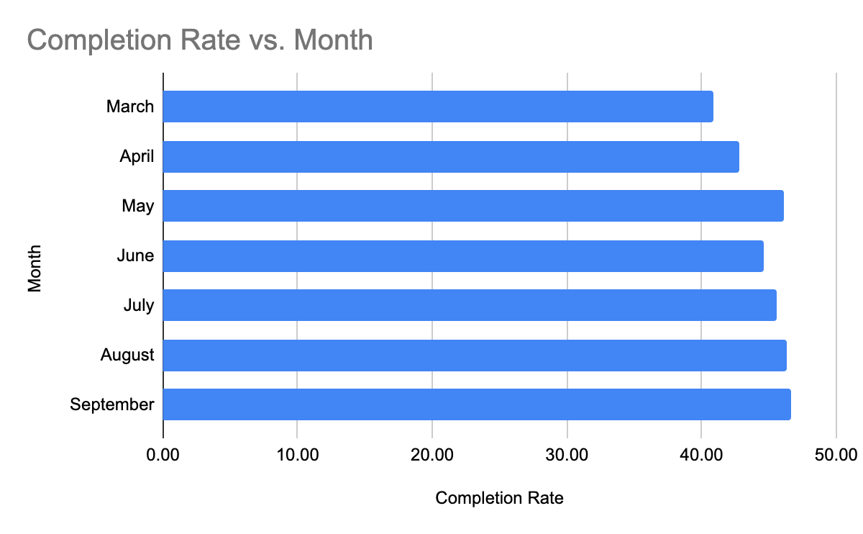
By Numbers
Month in Review
Released update supporting variations of VVC appointments
Released iteration on Cerner offboarding experience as prep for Spokane go-live
Started iteration on ‘Facility Selection’ page - launching in 2 phases
Kicked off community care provider selection
Added more app analytics tracking for VVC and Community Care
Addressed key tech debt
Total Users: 107,195
New Users: 3,400
Sept - 47% completion rate
Total Submissions - 27,193

Slide 10
VVC Appointments
DEMO
There are 8 different types of virtual video connect appointments. In the VAOS veteran-facing app, we addressed the key VVC appointment kinds that need to be represented to Veterans.
VA Video Connect at home
Maps to:
Ad hoc - single & Mobile_Any Kinds
VA Video Connect at
VA facility
Maps to:
Clinic_based kind
VA Video Connect at
ATLAS location
Maps to:
Ad hoc - ATLAS Assc. & Mobile_any ATLAS Assc.
VA Video Connect at using VA device
Maps to:
Mobile_GFE
We focused on designs that better informed users of the above 4 buckets & where possible included provider information.

Slide 11
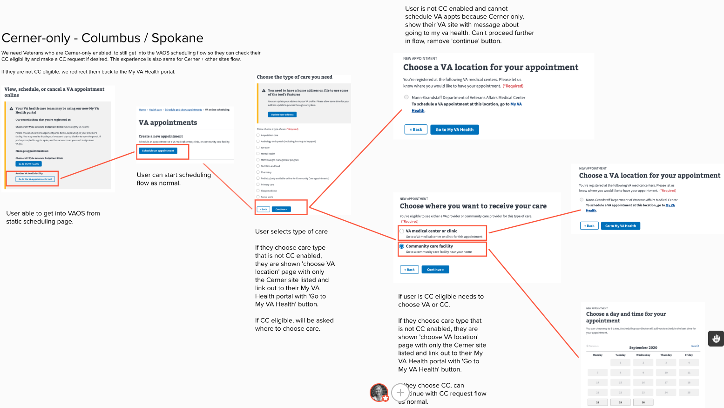
Cerner Offboarding Iteration
DEMO
Given current limitation of My VA Health (Cerner) portal to support community care requests, we made additional improvements to better support Cerner-enabled,
community care eligible Veterans.

Slide 12
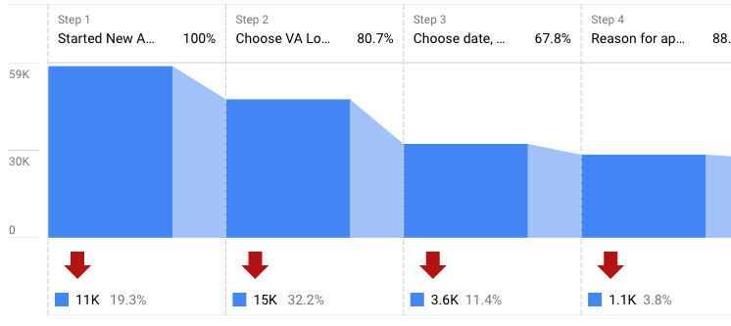
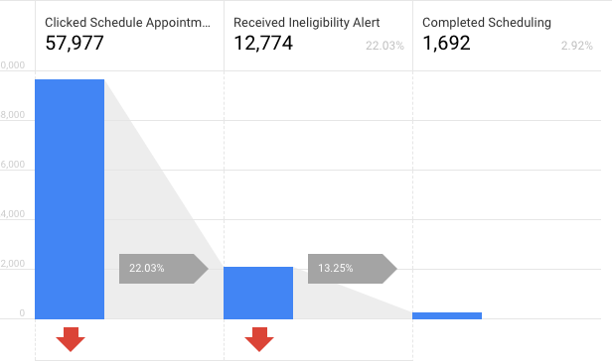
VA Request Product Analytics & Feedback
We have observed highest drop off of users on VA Facility selection page - 32%
13.25% of that drop off is due to users receiving the alert “This facility does not allow online requests for this care type"
We’ve received user feedback that “CBOCs not showing” or “incorrect facility”
We confirmed in recent user testing that user’s believe their “facility was missing” if confused by design
We believe current design accounts for remaining 19% of drop off which also corresponds to the 21 % of user feedback below
19.3% of users are drop out because they do not see the care they need
 | Number | Percentage
CBOCs not showing | 60 | 15%
Incorrect facility | 23 | 6%
Specialty not supported | 73 | 19%
Process issue | 26 | 7%
Reschedule Functionality | 15 | 4%

Slide 13
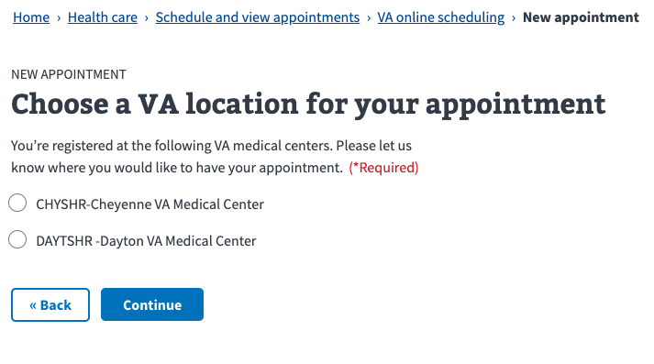
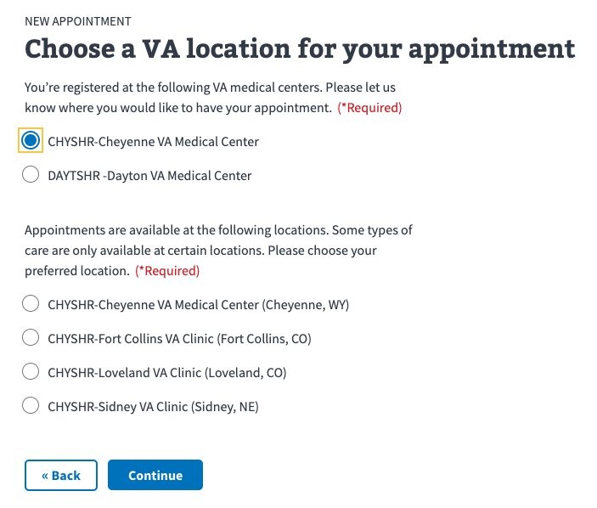
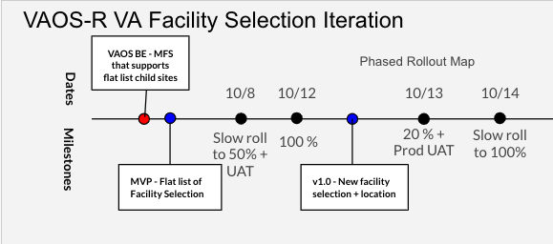
Iteration on Facility Selection page for VA Requests
DEMO
Step 1. Select Parent site
Step 2. Select Child site

Slide 14
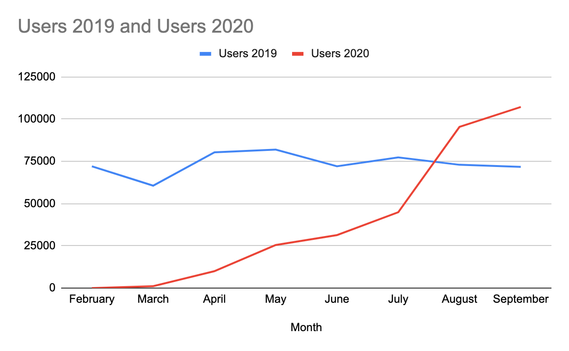
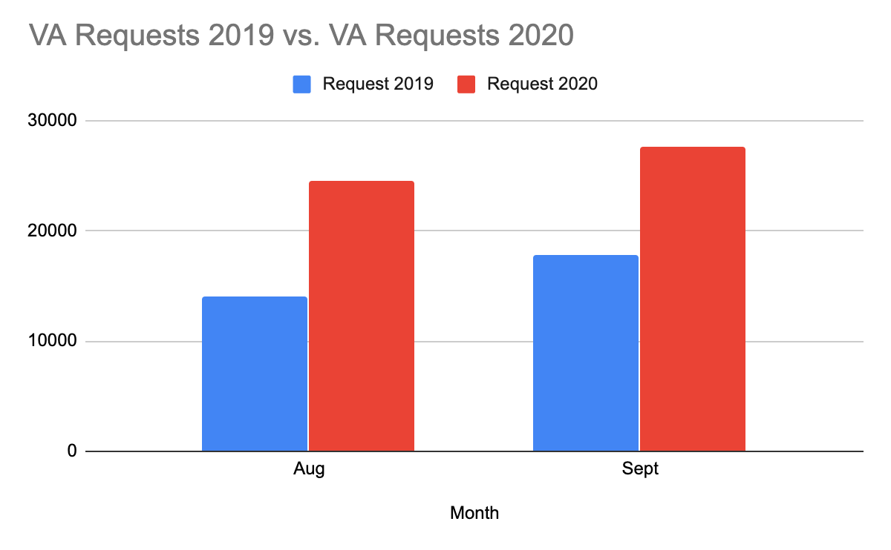
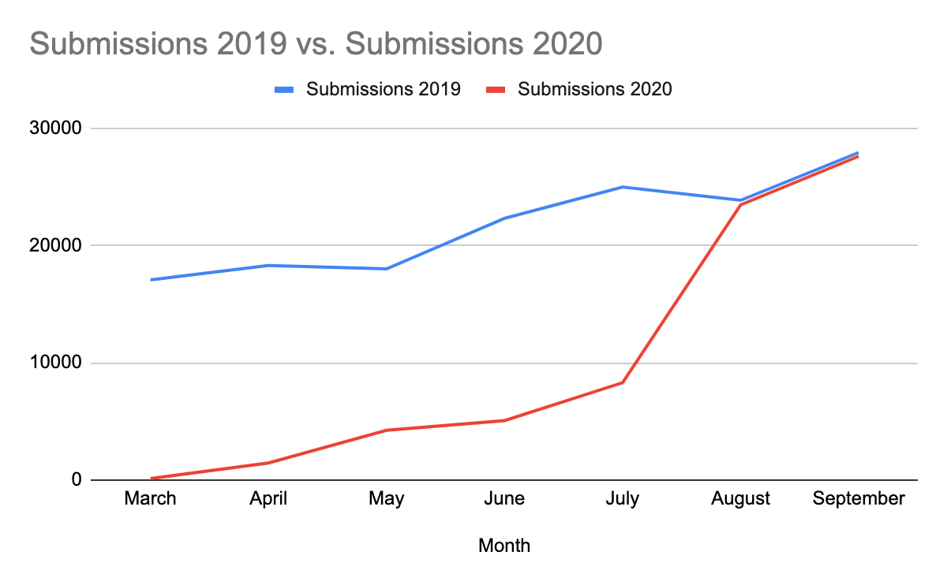
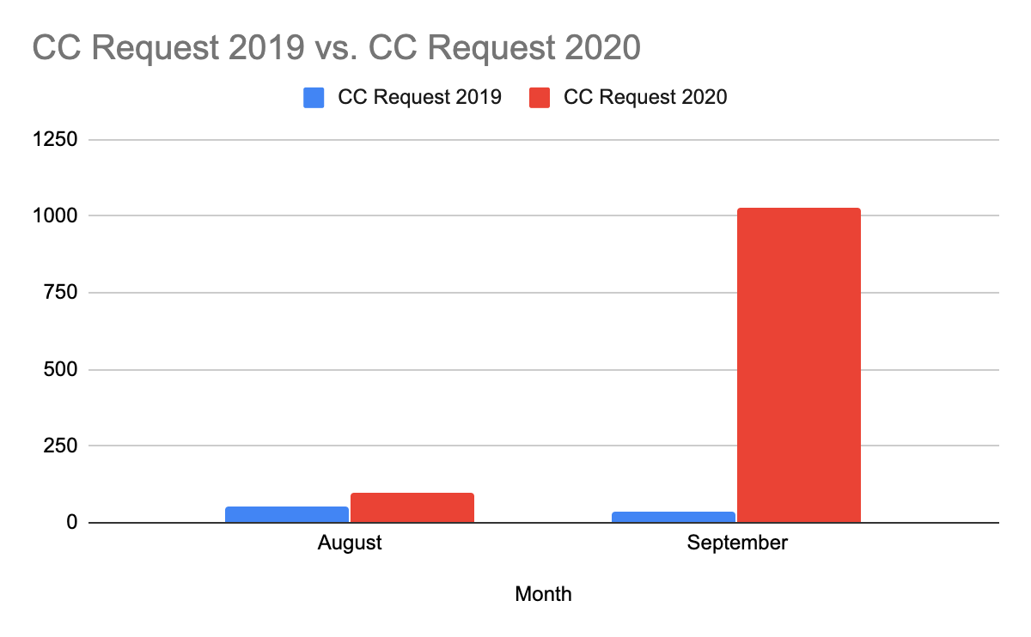
Historical Comparisons
VA Requests
Users logging in to app
Community care Requests
Total Submissions

Slide 15
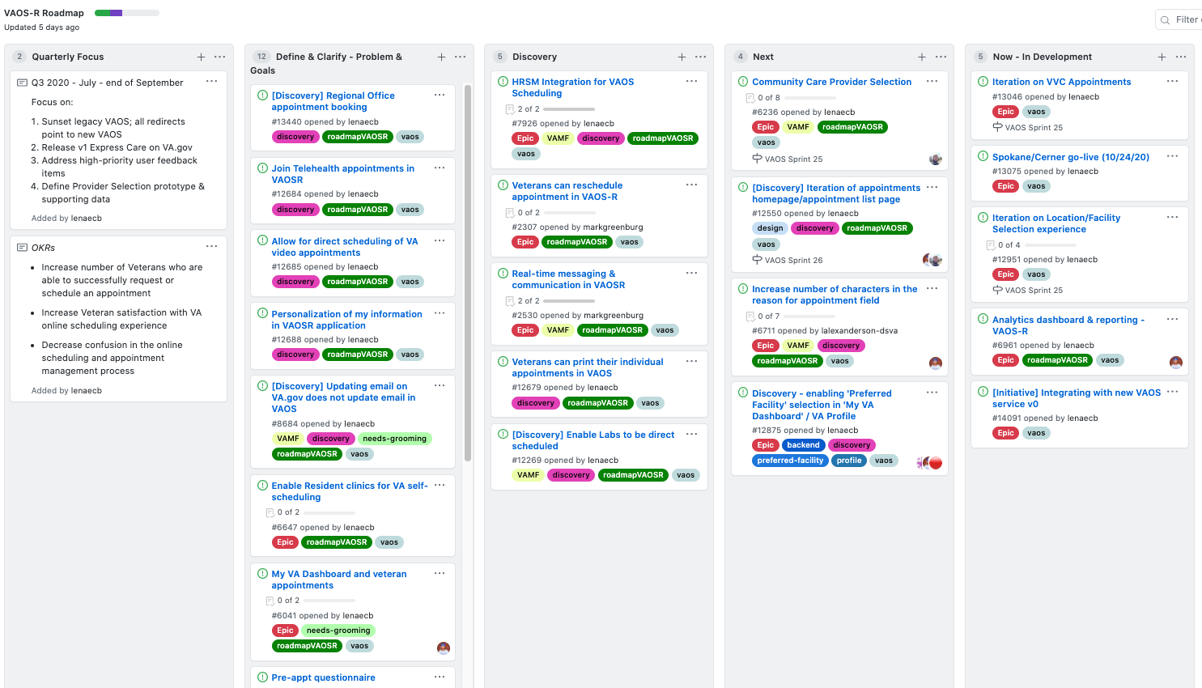
Roadmap & Backlog
Releasing facility selection iteration
Supporting Cerner go-live
Testing cc provider selection prototype + aligned technical strategy w/ PPMS
Iterating on VAOS homepage/dashboard
Supporting VAOS BE new VAOS v0 service
https://github.com/department-of-veterans-affairs/va.gov-team/projects/13

Slide 16
Status and Roadmap Update VAOS-R Services
2020-10-06: October 2020 Status Update

Slide 17
VAOS Milestone 1 (Time to Market/TtM)
Primary Changes:
No EAS/FHIR interface initially
Still provides a (different) path to R4 FHIR-based EAS
Mobile Appointment Service (MASv2) supports full management (read/write) for CC and VistA appointments
Replaces VAOS»VSS interface
VAOS service manages Veteran- and site-specific scheduling rules
Appointment Request Service (ARS) manages VAOS, Express Care appointment requests
Requests serviced through VSE GUI

Slide 18
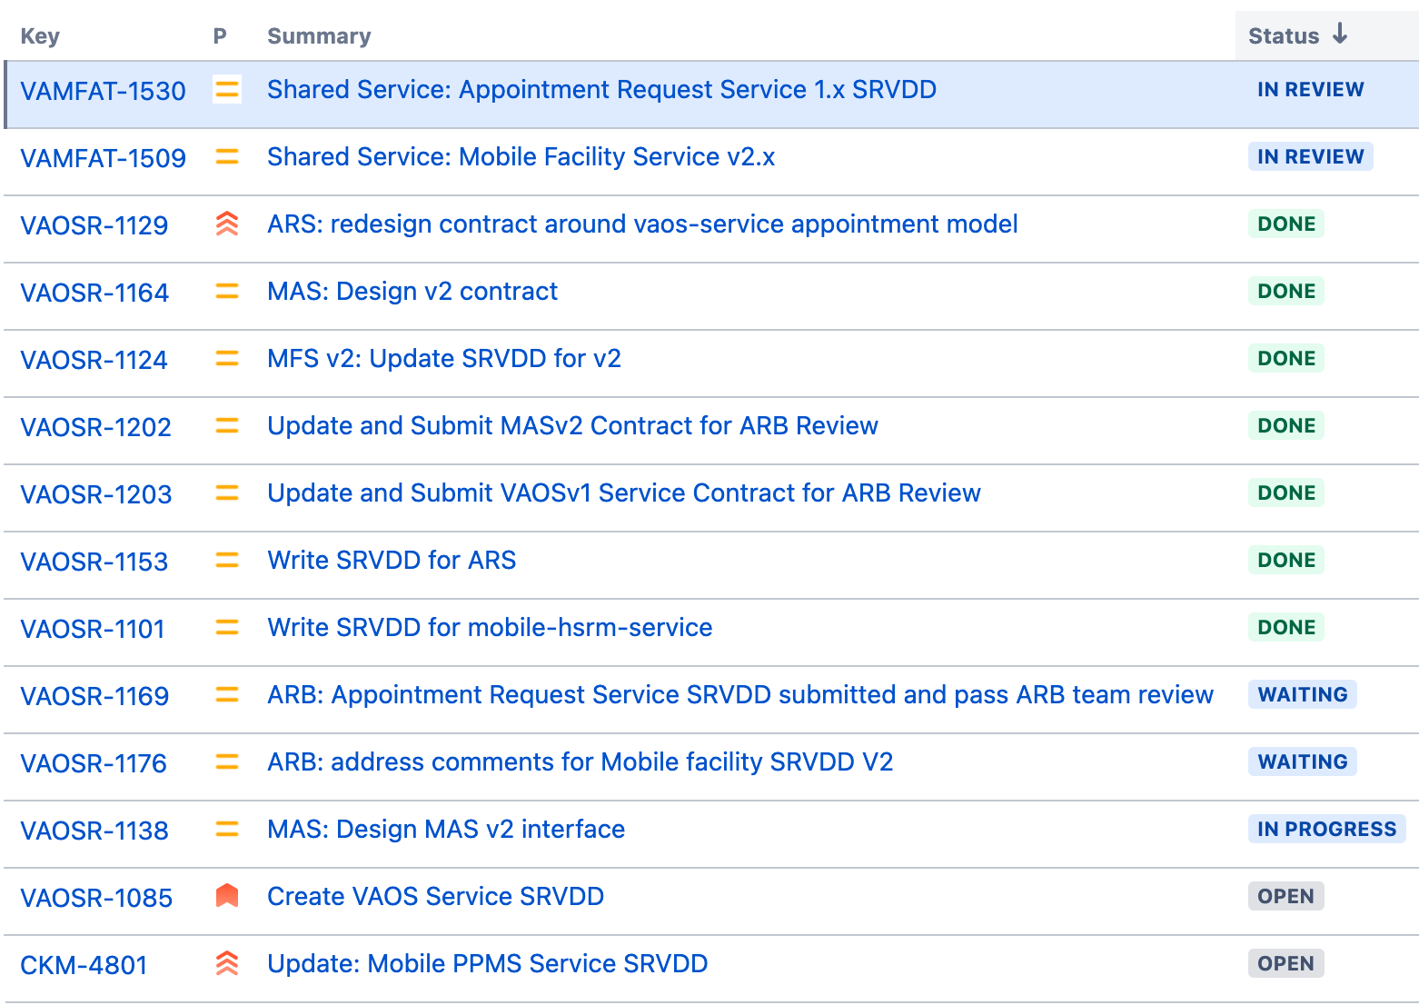
TtM- System Design Document Progress
Milestone 1 (TtM)
VAOS v1 Service
Mobile Facility Service (MFS) v2
Mobile HSRM Service v1
Mobile PPMS Service v1
Mobile Appointment Service (MAS) v2
Appointment Request Service (ARS) v1
Tracked as VAOSR-1201
Completed:
Appointment Request Service v1 (In Review)
Mobile Facility Service v2 (In Review)
Mobile HSRM Service v1 (In Review)
Mobile PPMS Service v1 (In Process)
Upcoming:
Mobile Appointment Service v2 (ETA 10/9)
VAOS Service v1 (ETA 10/16)

Slide 19
Recent Discussions & Decisions
VistA Appointment Requests / VSE GUI
VIA/VistA appointment requests are not possible short-term (ETA: Q2 2021)
VSE GUI to manage Veteran-generated appointment requests by connecting to VA Mobile / ARS
Allows for sunsetting of Scheduling Manager (SM)
Cerner Proxy User / Veteran Delegation
Upcoming request to support Veteran delegation through IAM to the My VA Health Portal (i.e. Cerner HealtheLife)
Coordination with VA.gov & MHV?

Slide 20
Recent Updates
Mobile Facility
VAOSR-1183: mobile-facility-service: JSP 3.3.1 upgrade
VAOSR-1124: MFS v2: Update SRVDD for v2
VAOSR-1122: MFS: Update to latest JSP
VAOSR-1120: MFS: Add VistA security key enforcement for write operations
VAR Resources
VAOSR-1151: Legacy Express Care URL Needs to Redirect to New UI
VAOSR-1184: var-resources: JSP 3.3.1 upgrade
VAOSR-1094: CERTUPD: Rebuild var-resources-v4:4.x for truststore updates
VAOSR-1083: VAR Resources: Update EmailNotificationWorker to use numeric detail code
VAOSR-1044: VAR Resources: Add numeric Detail Code identifier column to VAR DB
VAOSR-1043: VAR Resources: Remove SM CC Booked Appointments Repository
VAOSR-1023: Modify (or create new) request-limit endpoint to allow multiple sites and return array
VAOSR-1019: OIS review for VAR Resources 4.22
VAOSR-1010: Error when submitting Express Care request with non-CDW facility name
HSRM
VAOSR-1101: write srvdd for Mobile-hsrm-service
Appointment Request Service (ARS)
VAOSR-1178: Re-create Appointment Request Service Repository
VAOSR-1153: Write SRVDD for ARS
VAOSR-1129: ARS: redesign contract around vaos-service appointment model
VAOSR-1131: Submit SRVDD to ARB
Enterprise Appointment Service (EAS)
VAOSR-985: EAS: Forward requests to VSP Location
Mobile Appointment Service (MAS)
VAOSR-1179: MAS: Replace cdw-service with mockserver for testing
VAOSR-1166: MAS: Filter appointments for veterans if the clinic name is prefixed with "XX"
VAOSR-1139: MAS: timezone needs to be mapped to a string
VAOSR-1103: MAS: Filter clinics for veterans that start with "ZZ" and not "ZZ-"
VAOSR-1080: Deploy MAS 1.20.0
VAOSR-1079: MAS: Add data source failure logging
VAOSR-1029: Research MAS error code response
VAOSR-1164: MAS: Design v2 contract

Slide 21
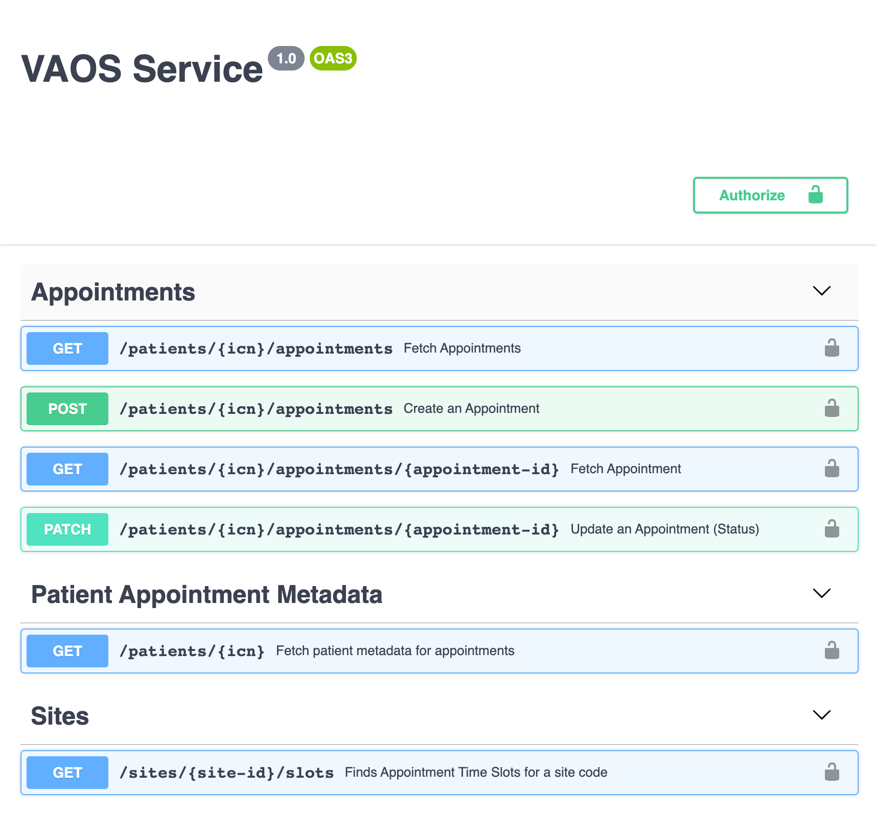
VAOS v1 Streamlined Interface
*Draft Interface Definition*
Simplified appointment-centric interface
Supports VistA/Clinic and CC Appointments
"FHIR-like" interface
Path to supporting Cerner appointments
Moves facility scheduling information and policy to Mobile Facility Service (MFS)
Delegates system-specific appointment management logic to Mobile Appointment Service (MAS)

Slide 22
Critical updates, action items, decisions, & questions

Slide 23
Critical updates
PI Planning is the week of October 26. Please try to join an Invision Freehand practice session prior to the PI planning.

Slide 24
Action Items, Questions, & Decisions: VVC
Mike’s team to determine if VVS service offers the name of Atlas facilities: Currently, the front end is not able to show a Veteran the name of the location for an ATLAS appointment (i.e. Walmart), only the address. If the name is available, we can determine how to add it; if not, we will need to add it to the table.
Kay to follow up on the outstanding questions about static/dynamic links for VA Video Connect appointments on a GFE ipad.
In early calendar year 2021 the static iPad links will be replaced with dynamic iPad links that are sent to the VA provided iPad. This work will be coordinated with the ROES integration work.
Lauren to connect Nancy, Dr. Galpin, Dr. Murphy to VA.gov identity team to discuss further how a mobile GFE iPad user could be able to use a dynamic link from an authenticated experience.

Slide 25
Action Items, Questions, & Decisions: Cerner handoff
Lauren provided content to Donna Alexander on the Cerner team so they can link back to VAOS for community care access.
Dr. Greenstone signed off on the updated Cerner handoff from VAOS to My VA health to preserve the community care experience.
Notes:
[4:30 PM] Case, Lynne M. (FEi Systems)is that because you are not using mobile-appintment-service?
[4:30 PM] Case, Lynne M. (FEi Systems)MAS is supposed to de-duplicate appointments
[4:30 PM] Jeff Balboni (Guest)The booked CC appointments that VAOS currently shows are not in MAS
[4:31 PM] Michael Ramirez (Guest)Because the frontend is calling to retrieve the booked CC appointments separately, I assume?
Yeah
[4:32 PM] Case, Lynne M. (FEi Systems)right, but the goal was for MHV and VA.gov to both pull from MAS so they get the same list
[4:32 PM] Case, Lynne M. (FEi Systems)so suggest if there are new rules, we get MAS updated
(1 liked)

Slide 26
Action Items, Questions, & Decisions: Facility Selection & Feedback
Lenae delineated the feedback loop and how we are addressing some of the feedback about facility selection in the front end.
Caveat: VAOS team cannot resolve Veterans’ concerns about the limited types of care available in online scheduling and the restrictions that facilities place in the types of care they permit to be scheduled online.
Kay: When will the new facility feature be in place:
A: we hope to try and get something out this week, but it's dependent on a VAOS BE release for an update to MFS. They are making plans on getting that update out hopefully soon.
Lauren to connect Mike’s team to identity team / CJ to discuss delegate experience.
Notes:
[4:30 PM] Case, Lynne M. (FEi Systems)is that because you are not using mobile-appintment-service?
[4:30 PM] Case, Lynne M. (FEi Systems)MAS is supposed to de-duplicate appointments
[4:30 PM] Jeff Balboni (Guest)The booked CC appointments that VAOS currently shows are not in MAS
[4:31 PM] Michael Ramirez (Guest)Because the frontend is calling to retrieve the booked CC appointments separately, I assume?
Yeah
[4:32 PM] Case, Lynne M. (FEi Systems)right, but the goal was for MHV and VA.gov to both pull from MAS so they get the same list
[4:32 PM] Case, Lynne M. (FEi Systems)so suggest if there are new rules, we get MAS updated
(1 liked)

